Slide 1

InforMARL: Scalable Multi-Agent Reinforcement Learning through Intelligent Information Aggregation
Siddharth Nayak
sidnayak@mit.edu

Slide 2




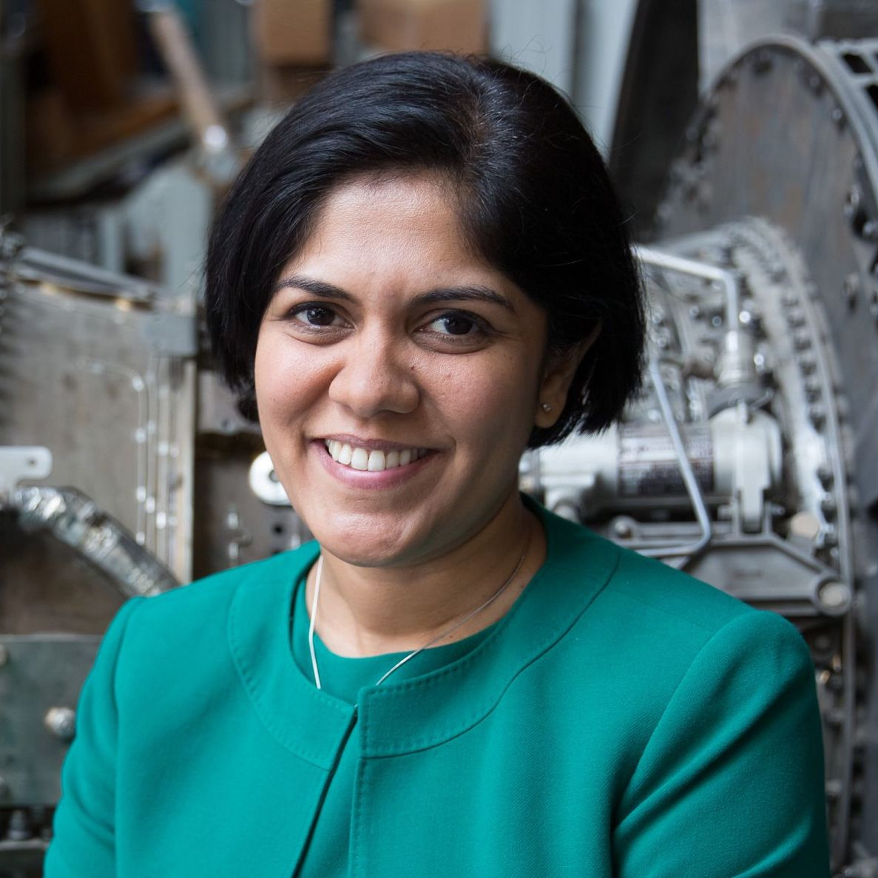


Joint work with:
Kenneth Choi
Wenqi Ding
Sydney Dolan
Karthik Gopalakrishnan
Hamsa Balakrishnan
This research was sponsored in part by the NASA University Leadership initiative (grant #80NSSC20M0163) and the U.S. AFRL/U.S. Air Force Artificial Intelligence
Accelerator (Cooperative Agreement Number FA8750-19-2-1000). The views and conclusions contained in this document are those of the authors and should
not be interpreted as representing the official policies, either expressed or implied, of NASA, the U.S. Air Force or the U.S. Government.

Slide 3
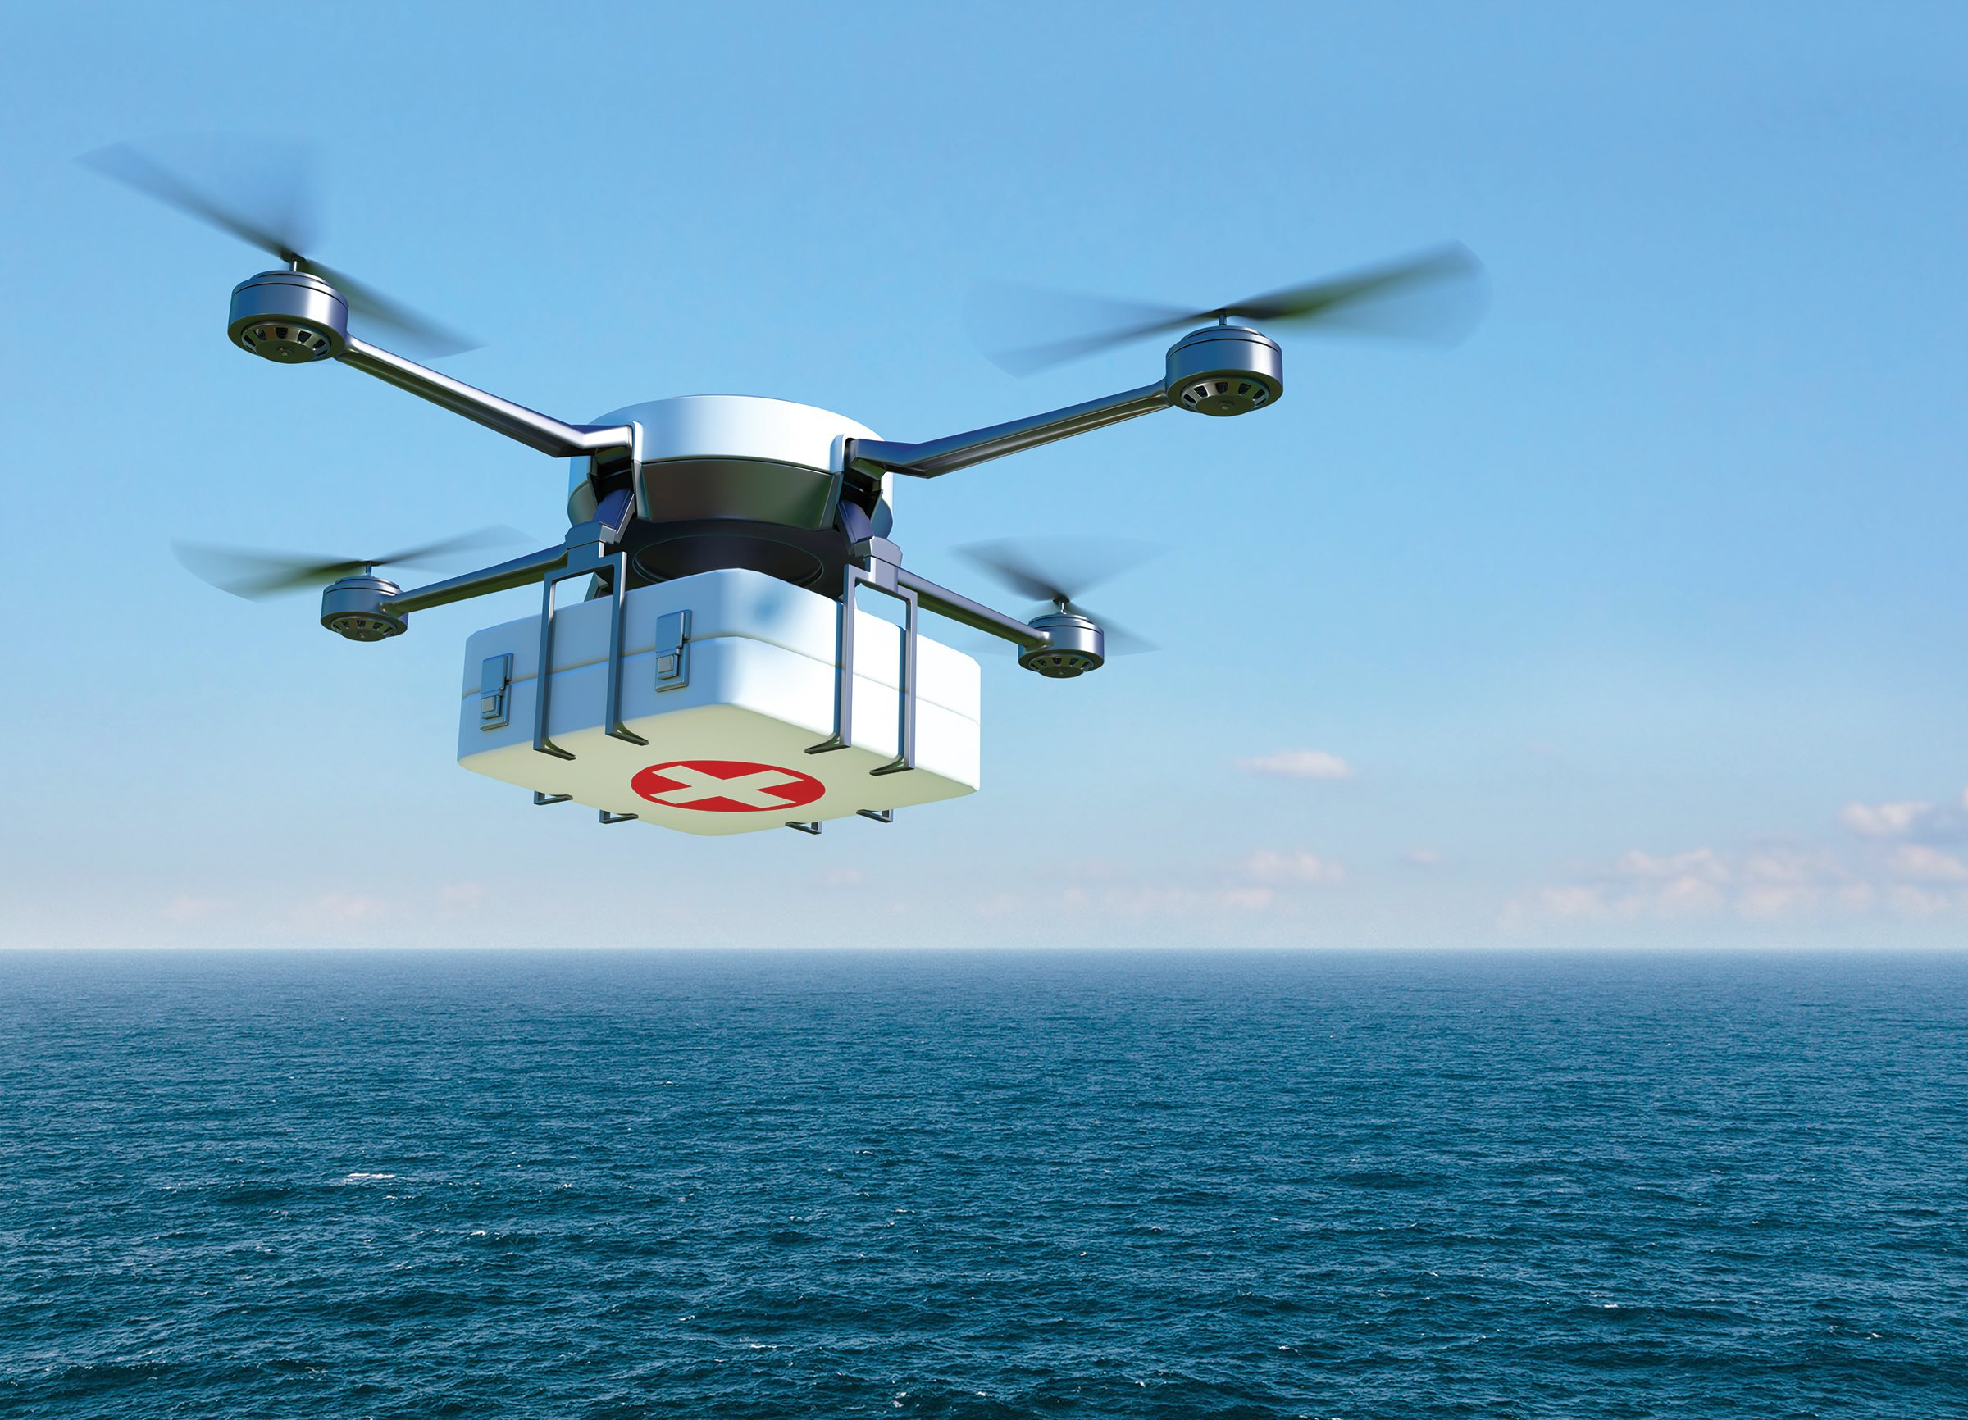
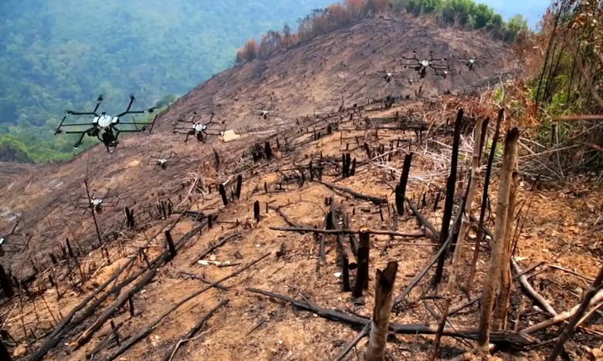
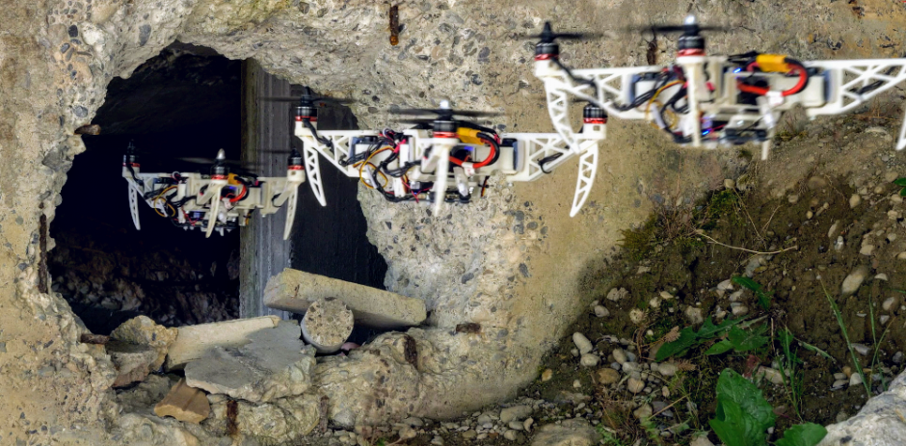
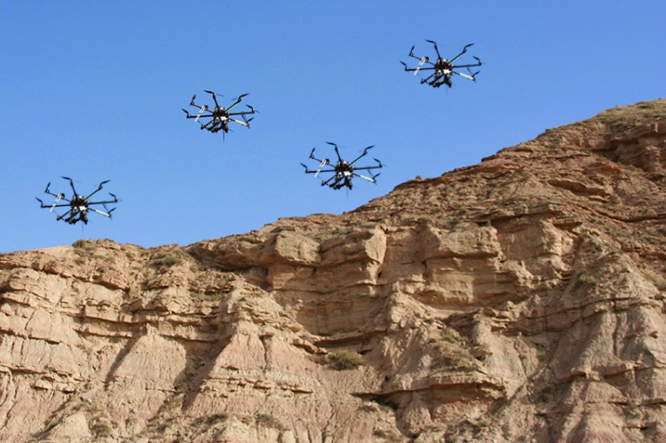
Background and Motivation

Slide 4
Background and Motivation
Key Features Expected from MARL Algorithms

Slide 5
Motivation: Scalability
MARL algorithms should work in scenarios with a large number of agents
Preferably be agnostic to number of agents in the environment

Slide 6
Motivation: Decentralized Execution
Each agent should be able to take decisions for itself
Should not depend on a centralized controller

Slide 7
Motivation: Training Time
MARL algorithms need a lot of training samples because of various issues like non-stationarity, partial observability, etc.
The amount of training required increases as the environment complexity increases

Slide 8
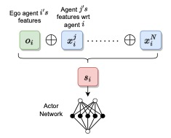
Motivation: Prior Approaches

Slide 9
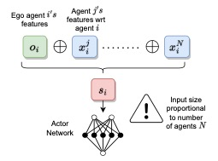
Motivation: Prior Approaches

Slide 10
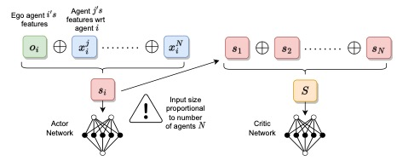
Motivation: Prior Approaches

Slide 11
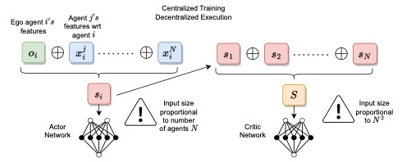
Motivation: Prior Approaches

Slide 12
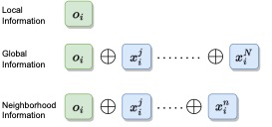
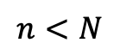
Motivating Experiment
$$n<N$$
Notes:
Replace n with nbd

Slide 13
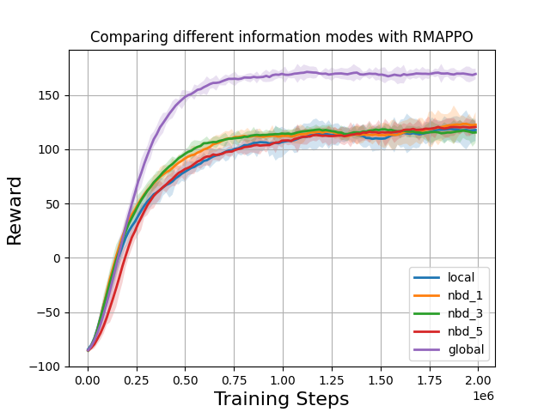
Motivating Experiment
• In practice, we just have
local information about the
neighborhood
• And naïve concatenation
of neighborhood
information doesn’t work

Slide 14

Motivating Experiment
Notes:
Add why informarl with getting globalized info is hard in localized information

Slide 15
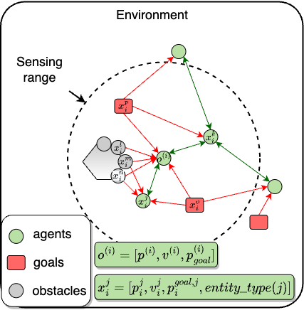
Method

Slide 16
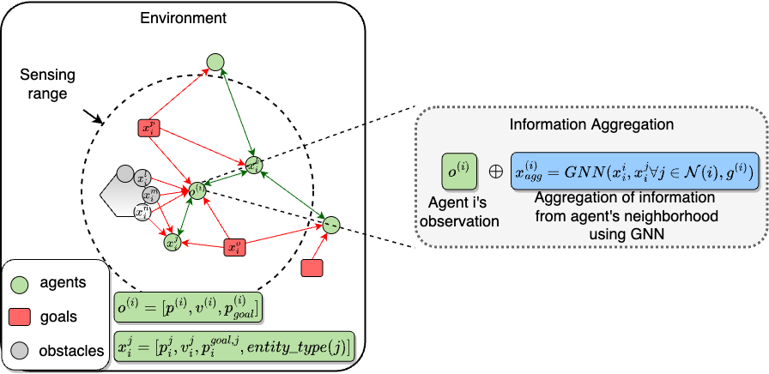
Method

Slide 17
Method
Inter-agent edges are bidirectional (communication edges)

Slide 18
Method
Agent and non-agent edges are unidirectional (sensing edges)

Slide 19
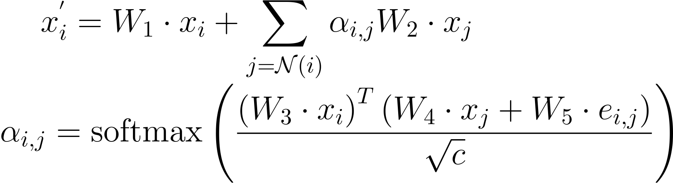
Method

Slide 20
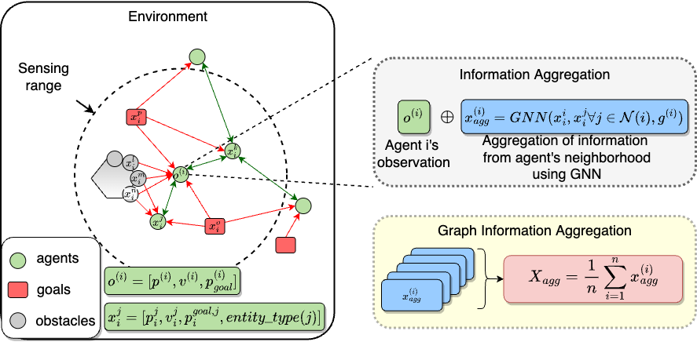
Method

Slide 21
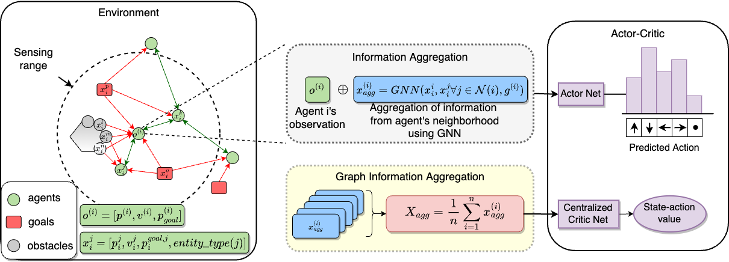
Method

Slide 22
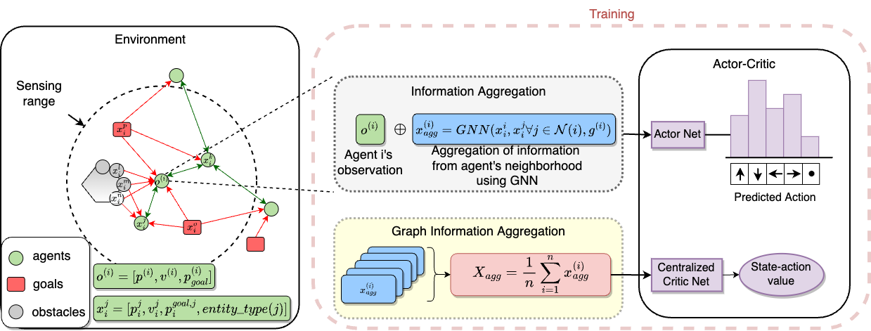
Method

Slide 23
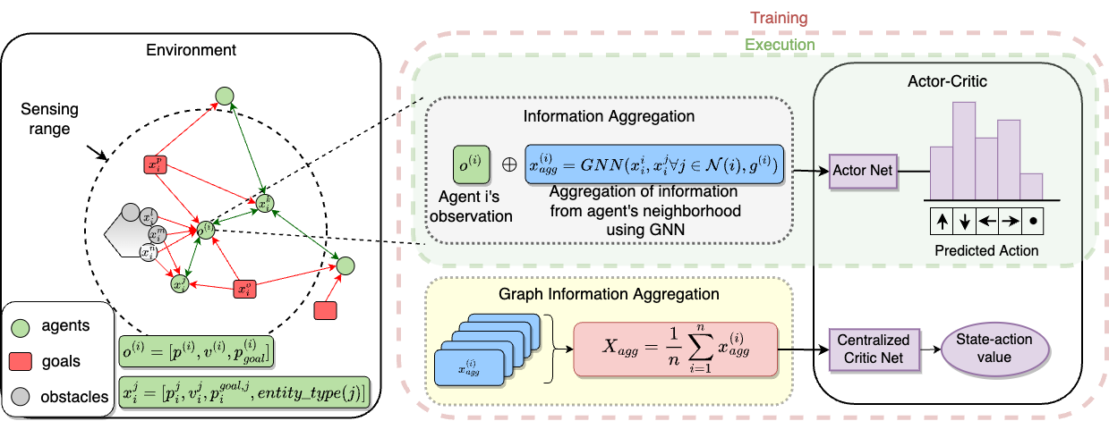
Method

Slide 24
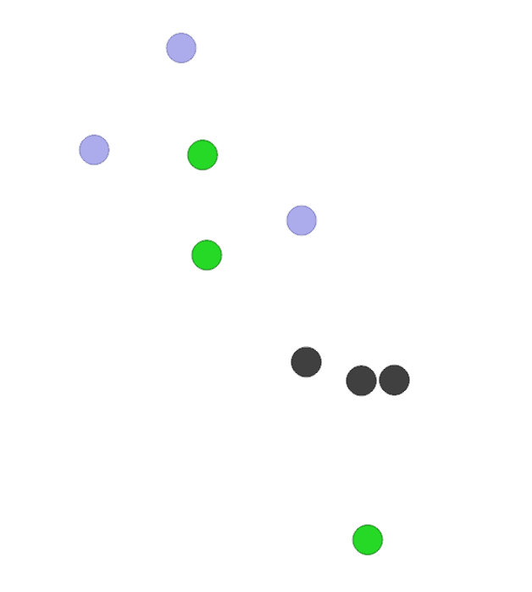
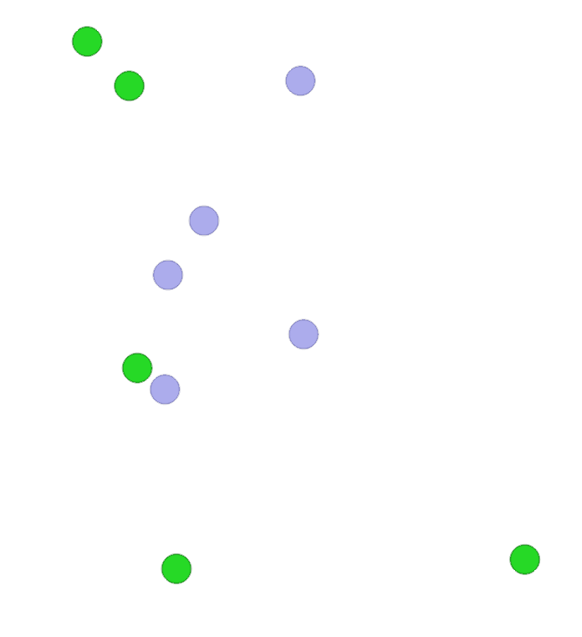
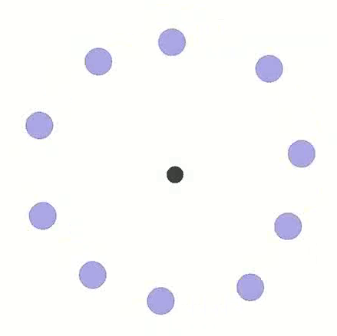
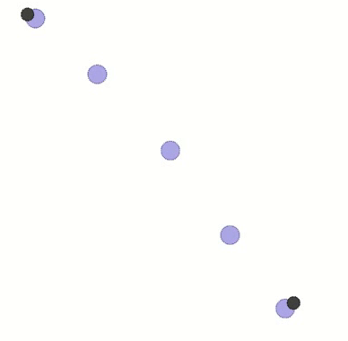
Experiments: Environments
Target
Coverage
Formation
Line Formation

Slide 25
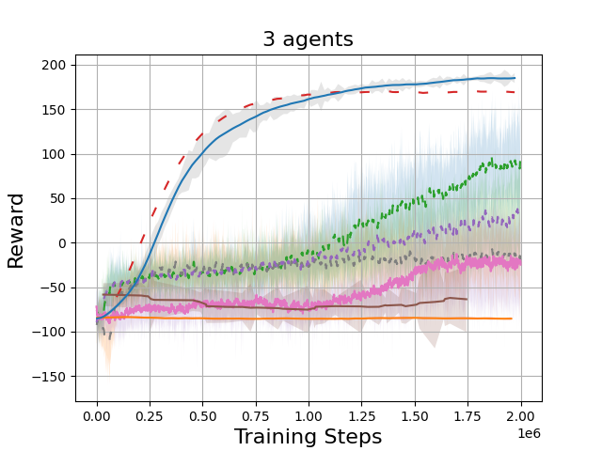
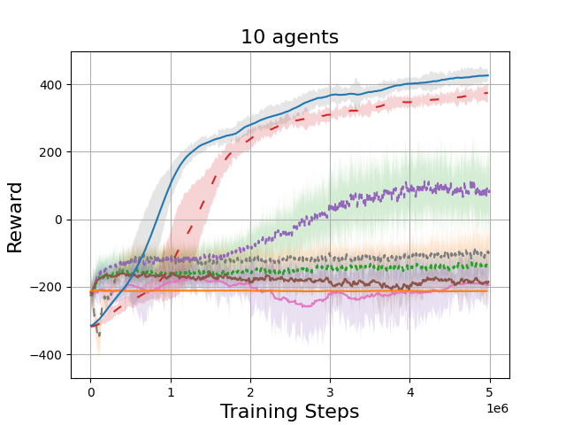
Experiments: Sample complexity

Slide 26
Experiments: Scalability
Training
 |  | n=3 | n=7 | n=10
m=3 | Reward/agent ↑ | 63.21 | 63.25 | 62.87
 | Avg. completion time ↓ | 0.39 | 0.40 | 0.40
 | Avg. #collisions/agent ↓ | 0.40 | 0.46 | 0.49
 | Completion rate↑ | 100% | 100% | 99%
m=7 | Reward/agent↑ | 61.16 | 62.23 | 61.32
 | Avg. completion time ↓ | 0.38 | 0.40 | 0.40
 | Avg. #collisions/agent ↓ | 0.74 | 0.66 | 0.70
 | Completion rate ↑ | 100% | 100% | 100%
m=10 | Reward/agent ↑ | 58.59 | 58.23 | 58.67
 | Avg. completion time ↓ | 0.38 | 0.40 | 0.39
 | Avg. #collisions/agent ↓ | 0.95 | 0.88 | 0.87
 | Completion rate ↑ | 100% | 99% | 100%
m=15 | Reward/agent ↑ | 53.19 | 53.46 | 54.21
 | Avg. completion time ↓ | 0.39 | 0.40 | 0.40
 | Avg. #collisions/agent ↓ | 1.28 | 1.21 | 1.20
 | Completion rate ↑ | 100% | 99% | 99%
Testing
↑ - higher better
↓ - lower better

Slide 27
Experiments: Other environments
Task environment | m | Metric | RMAPPO (global info) | InforMARL (local info)
Coverage | m=3 | Avg. completion time ↓ | 0.34 | 0.36
 |  | Completion rate ↑ | 100% | 100%
 | m=7 | Avg. completion time ↓ | 0.42 | 0.43
 |  | Completion rate ↑ | 100% | 99%
Formation | m=3 | Avg. completion time ↓ | 0.31 | 0.30
 |  | Completion rate ↑ | 100% | 100%
 | m=7 | Avg. completion time ↓ | 0.47 | 0.43
 |  | Completion rate ↑ | 100% | 100%
Line | m=3 | Avg. completion time ↓ | 0.24 | 0.21
 |  | Completion rate ↑ | 100% | 100%
 | m=7 | Avg. completion time ↓ | 0.38 | 0.36
 |  | Completion rate ↑ | 100% | 100%
↑ - higher better
↓ - lower better

Slide 28
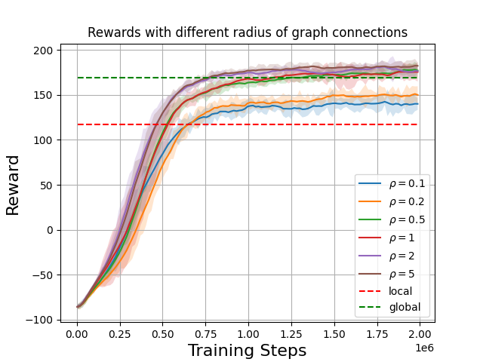
Effect of Sensing Radius
Vary the sensing radius for InforMARL
Diminishing returns in performance from increasing sensing radius

Slide 29
Conclusions
InforMARL uses a graph neural network (GNN)-based architecture for scalable multi-agent RL in a decentralized fashion.
InforMARL is transferable to scenarios with a different number of entities in the environment than what it was trained on.
InforMARL has better sample complexity than most other standard MARL algorithms with global observations
Add strict safety constraints for guaranteeing no collisions

Slide 30
Thank You
Questions we couldn’t get to?
Ideas to collaborate?
Drop me an email at sidnayak@mit.edu

